Slide 1
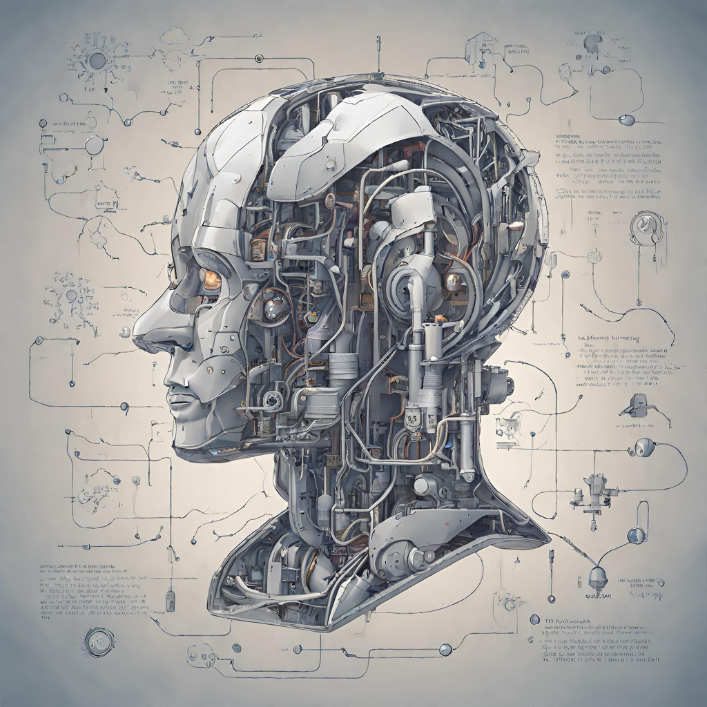
Disease Prediction using Machine Learning Algorithms
Presentation
Pratheeka M U

Slide 2
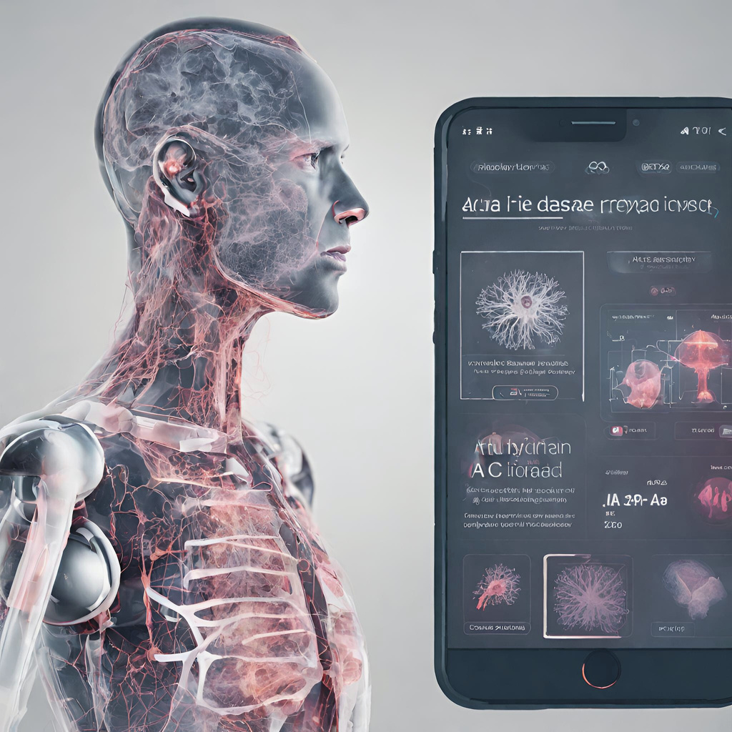
Introduction
In this project, we focus on leveraging machine learning algorithms to predict diseases based on symptoms, aiming to revolutionize diagnostic processes in healthcare. By integrating advanced algorithms with a user-friendly interface developed using Tkinter, our goal is to create a system that facilitates accurate disease prediction, aiding healthcare professionals in decision-making and improving patient care.

Slide 3

Problem Statement
Our project addresses the challenge of automating disease diagnosis by utilizing machine learning techniques. Manual diagnosis is time-consuming and prone to human error, leading to delays in treatment and potential misdiagnoses. This project aims to streamline and enhance the diagnostic process by predicting diseases based on symptoms with high accuracy.

Slide 4

Methodology Overview
The project involves a systematic approach: starting with collecting a diverse dataset encompassing symptoms and associated diseases. We preprocess this data to ensure its quality, encode categorical variables (such as symptoms), and then engineer features, primarily focusing on symptoms as predictive factors. Utilizing various machine learning algorithms like Decision Trees, Random Forests, K-Nearest Neighbors, and Naive Bayes, we train models to predict diseases based on symptoms. The models' performances are evaluated using standard metrics.

Slide 5


Integration with Tkinter
We chose Tkinter to develop a user-friendly graphical interface, allowing users to input symptoms easily. This interface seamlessly interacts with our machine learning models to provide disease predictions based on the entered symptoms. It ensures accessibility and simplicity in using the predictive system.

Slide 6


Conclusion
In conclusion, our project signifies a promising step towards revolutionizing disease diagnosis. The amalgamation of machine learning algorithms and a user-friendly interface holds immense potential to streamline diagnostic processes, ultimately benefiting healthcare providers and patients alike.

